Slide 1
FLAS Infoshare
Summer 2025
Academic Year 2025-26
HAMILTON LUGAR SCHOOL OF GLOBAL & INTERNATIONAL STUDIES
INDIANA UNIVERSITY BLOOMINGTON

Slide 2

Foreign Language and Area Studies (FLAS) Awards
FLAS awards are funded by the United States Department of Education in support of students studying less commonly taught languages and cultures, in particular those considered to be of critical interest to the United States: almost any language except German, French, & Spanish.
FLAS is intended for students who plan to make their careers in college or university teaching, government service, or other employment where knowledge of foreign languages and cultures is a prerequisite for success.
Indiana University has eight FLAS-granting centers offering dozens of languages.

Slide 3
Award Amounts
Summer 2025
$3,500 stipend + tuition award up to $5,000
Academic Year 2025-2026
Undergraduate:
$5,000 stipend + tuition award of $10,000
Graduate students:
$20,000 stipend + tuition award of 24 credit hours + health insurance

Slide 4
FLAS is for study at IU or abroad
Academic Year 2026-26 (Must be IU student)
FLAS recipients must be enrolled in one language course and one area studies course during each semester.
Doctoral level students are able to conduct dissertation research abroad. No course requirements apply.
Summer 2024
Only for intensive language study – no area studies course required.
Consider IU Summer Language Workshop!
Study abroad is contingent upon travel restrictions and Center approval

Slide 5
Eligibility
Must be US citizen, US national, or US permanent resident. Unfortunately, international students are not eligible.
Must be an IU student for the AY award. Non-IU students are eligible for the summer award if they study at the IU Summer Language Workshop.
Language levels:
  Undergraduate FLAS awards are not available for language study at the introductory level (level 1). Undergraduate students must apply for intermediate level language instruction (Level 2) or higher.
  Graduate students may apply for Level 1 language study only if you already have advanced proficiency in another language related to your studies. Strong preference is given to applications for intermediate and advanced language study.
For Summer: students who plan to graduate prior to their summer program remain eligible only under certain conditions, including being enrolled in an academic program by Fall 2025.

Slide 6
How to Apply
go.iu.edu/FLAS
Applications open December 2, 2024
Application deadline: January 26, 2025

Slide 7
Application Materials
Fill out application at go.iu.edu/IUFLAS
Request two letters of recommendation (line up recommenders ASAP)
Submit official transcripts for ALL colleges and universities attended:
    No official transcripts needed for IU coursework
    High school transcripts are not necessary, unless you are an incoming Freshman
    Official transfer credit will be reflected on your IU transcript
    Official transcripts submitted to IU for admissions can be forwarded
      Send email to admissions/home department and FLAS requesting transfer
Statement of Purpose Essay – suggested no more than 2 pages single spaced
Free Application for Federal Student Aid (FAFSA) – AY applications only required – send to IU Bloomington
Application deadline: January 26, 2024 – ALL materials should be in.

Slide 8
Application Tips
Apply to more than one center! You will indicate which centers you wish to apply to on your application, and your letters of recommendation and transcripts will automatically be supplied to each center indicated.
Research the center you’re applying to and identify how your studies align with their mission. A successful statement of purpose will reflect this understanding.
Highlight how your current research or future career may contribute to areas of national need.
You can apply to receive funding in summer and during the academic year and can receive awards for both.
One application for each term and language. Example:
  Academic Year Persian to CSME, IAUNRC, CGC, ISP
  Academic Year Arabic to CSME, CGC, ISP
  Summer Arabic to CSME, CGC, ISP
  You will load each statement of purpose for each center to the application.
  FLAS Program Manager will get all supplemental materials like transcripts to each center – you only need to submit those once.

Slide 9
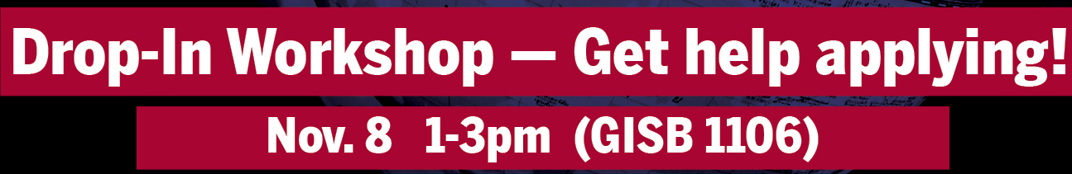
Application Tips cont.
Grads: visit the GradGrants Center in Wells Library to get feedback on your application materials.
Workshop open to all
  Graduate and undergraduate FLAS recipients available for feedback and application review.
  Peer mentors with information about languages and school/life balance.
  Learn about FLAS Centers and other funding opportunities, as well as information from Writing Tutorial Services.

Slide 10
FAQs
  Why do I need to pick which FLAS center(s) to apply to?
  Each FLAS center has its own pool of funds and reviewing committee. You want to maximize your chances of getting funding, however you should only apply to relevant centers. If chosen, you will receive one offer from one center.
  Can I apply for more than one language?
  Yes, however, you can only receive FLAS for one language at a time. You will need to submit a separate application for each language.
  Can I accept FLAS if I have another scholarship?
  Typically yes; your award package will be reviewed on a case-by case basis. You cannot receive funds for the same purpose, like tuition from FLAS and 21st Century Scholar.
  Can I take my language and/or area studies course online? Yes, providing that you’re working with an instructor via a synchronous online course or independent study. Asynchronous courses are not permitted.

Slide 11
  Can I use my Academic Year award at other institutions? Yes. Many students study abroad during the academic year.
FAQs
I’ve received a FLAS award in the past. Can I receive one again? Yes. There is no limit to how many times you can receive a FLAS award over the course of your studies.
Can I use an Associate Instructor or employer as one of my recommenders? Yes, but we advise that you find two faculty recommenders when possible, especially if they are a language instructor. Recommenders do not have to be from IU if you attended another institution recently.

Slide 12
  Can I get FLAS for the Fall or Spring semester only? No. The AY FLAS term is both Fall and Spring.
FAQs
How will I know my language proficiency level? Your level depends on your completed coursework or a proficiency exam. Proficiency exam NOT necessary to apply for FLAS, and language place questions can be answered by your center.
I’m a graduate student who has been offered an AI position. Can I receive a FLAS award? Sometimes. It is at the discretion of your center and must be approved.
When will I know the competition results? Typically by the end of March. Notifications for both summer and academic year will go out as each center makes their decisions.

Slide 13
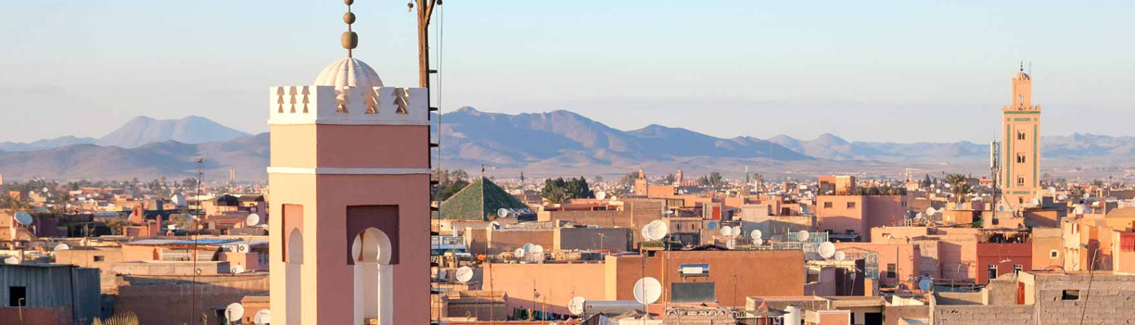
Indiana University FLAS-Granting Centers
African Studies Program
The IU African Studies Program is recognized as one of the leading centers for the interdisciplinary study of Africa. A Title VI National Resource Center, our diverse research, teaching, and outreach activities promote greater understanding and appreciation of the continent and its global diaspora.
Akan/Twi
Arabic (Africa-based only)
Bamana
Swahili
Yoruba
Zulu
*Other languages like Igbo and Kinyarwanda are summer only languages.
Contact Tavy Aherne
taherne@iu.edu

Slide 14

Indiana University FLAS-Granting Centers
Inner Asian & Uralic National Resource Center
Azerbaijani*
Estonian
Finnish
Hungarian
Kazakh**
Kurdish
Kyrgyz**
Mongolian
Pashto*
Persian
Tajik*
Tibetan
Turkish
Uyghur
Uzbek
*Available for Summer FLAS only
** FLAS for the academic year Kazakh or Kyrgyz depends on the availability of instructors. You will be considered for these languages, but we encourage you to submit a second application for a different IAUNRC language.
For over sixty years, the Inner Asian and Uralic National Resource Center at Indiana University has served as the country’s paramount institution for supporting the study of Central Eurasia. The Center creates and coordinates the delivery of resources to increase understanding of all aspects of the diverse peoples, languages, and areas within our region.
Contact Kasia Rydel-Johnston
krydeljo@iu.edu

Slide 15

Indiana University FLAS-Granting Centers
Center for the Study of the
Middle East
CSME is a Title VI Comprehensive National Resource Center. This is a particularly prestigious designation, conferred by the U.S. Department of Education, and shared by CSME and only 14 other Middle East centers at universities across the United States.
We promote knowledge of the Middle East by providing enrichment to academic programs, scholarship, public outreach, and support for educators and students at all levels.
Arabic
Hebrew
Turkish
Persian
Kurdish
Contact Carl Pearson
pearsonc@iu.edu

Slide 16
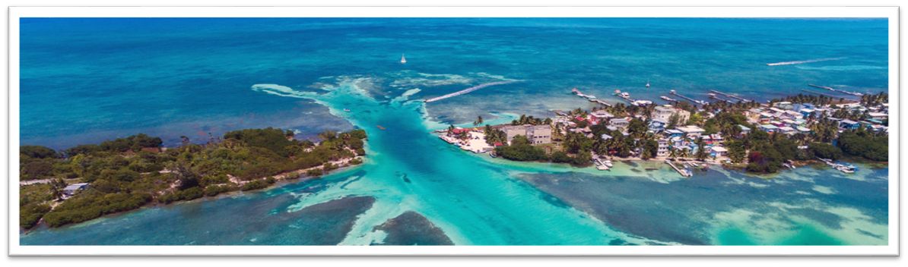
Indiana University FLAS-Granting Centers
Center for Latin American and Caribbean Studies
Portuguese
Haitian Creole
Maya
Quechua
Contact Sonia Manriquez
soimanri@iu.edu
The Center for Latin American and Caribbean Studies has supported outreach initiatives and educational programming focused on highlighting Latin American and Caribbean topics and communities in a global setting for the last 6 decades.

Slide 17

Indiana University FLAS-Granting Centers
Islamic Studies Program
Contact Alina Bessenyey Williams
williali@iu.edu
Arabic
Bamana
Persian
Russian
Swahili
Turkish
Urdu
Uyghur
Uzbek
The Islamic Studies Program advances critical research about Islam and the Muslim world and facilitates access to knowledge in the field for students, scholars, professionals, and the public. The Program designs and supports curricular and collaborative initiatives and assists faculty and students in developing research projects that focus on the rich diversity of Muslim history, politics, culture, thought, and practice.

Slide 18

Indiana University FLAS-Granting Centers
Robert F. Byrnes Russian & East European Institute
REEI is recognized as one of the top Russian and East European Area Studies institutions in the United States, and we have been a continuously-funded U.S. Department of Education Title VI National Resource/FLAS Center for more than sixty years.
Russian
Ukrainian
Estonian
Hungarian
Czech
Polish
Romanian
Bosnian
Croatian
Serbian
Lithuanian
Latvian*
Lithuanian*
Georgian*
Tatar*
Modern Greek
Yiddish
*Available for Summer FLAS only
Contact Lindsey Grutchfield
lwgrutch@iu.edu

Slide 19
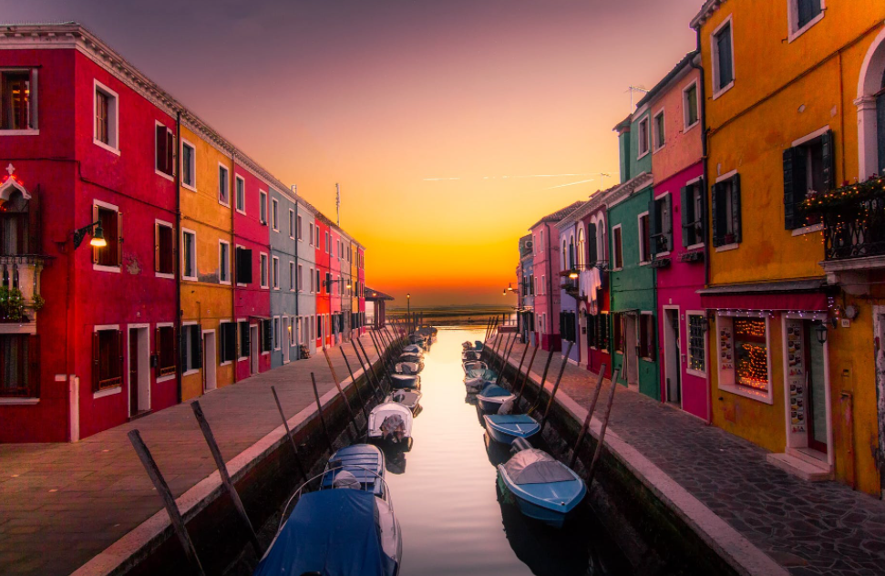
Indiana University FLAS-Granting Centers
Institute for European Studies
Arabic
Bosnian
Croatian
Serbian
Catalan
Dutch
Haitian Creole
Hungarian
Italian
Modern Greek
Norwegian
Polish
Portuguese
Estonian*
Finnish*
Ukrainian*
Contact Colton Ames
colames@iu.edu
*Pending additional approvals
EURO at IU promotes knowledge of Europe and the European Union through education, scholarship, and public outreach. Our academic degree programs train specialists committed to strengthening transatlantic ties through careers in public service, business, research, and teaching.

Slide 20
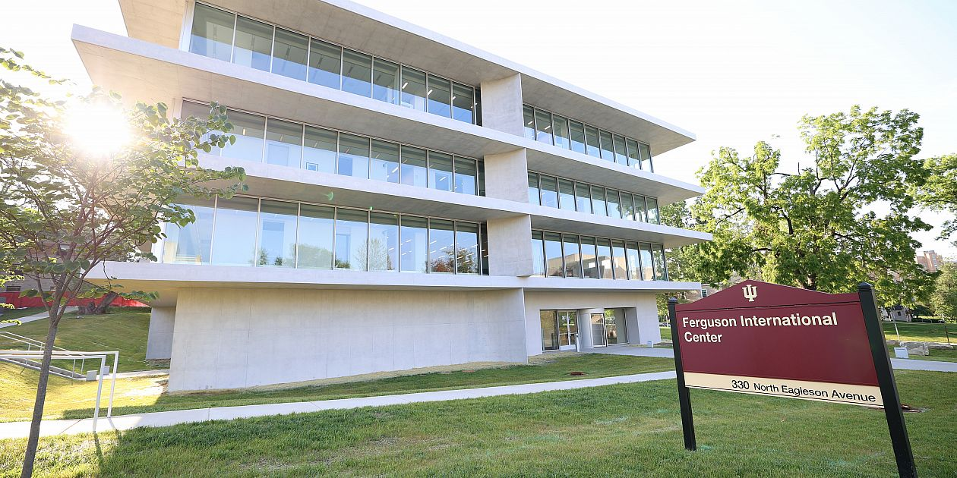
Indiana University FLAS-Granting Centers
Center for the Study of Global Change
Arabic
Bamana
Chinese (Mandarin)
Hindi
Italian
Japanese
Korean
Persian
Portuguese
Russian
Swahili
Turkish
Urdu
Contact Celina Jaffe
cejaffe@iu.edu
The Global Center is a hub of internationalization, global scholarship and learning, innovative partnerships, and interdisciplinarity at Indiana University and beyond. We create diverse and inclusive learning environments that foster global engagement, understanding, and responsibility.
CGC can also seek approval for additional languages assuming your research or areas of study are transnational, cross-regional, comparative, or global.

Slide 21
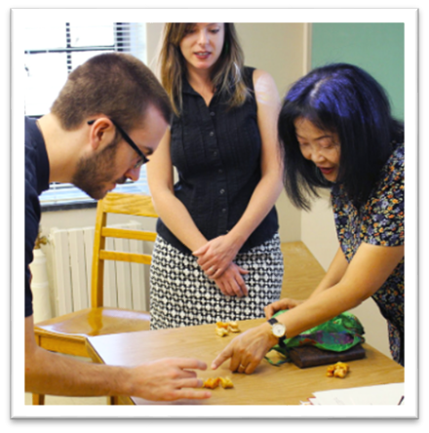

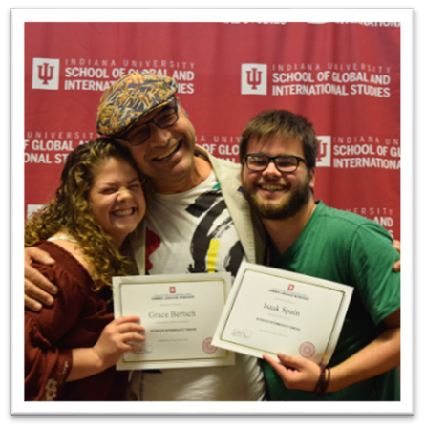
Hamilton Lugar School
Language Workshop languageworkshop.indiana.edu
Arabic
Azerbaijani
Bosnian/Croatian/ Serbian
Chinese
Chuvash
Dutch
Estonian
Finnish
Hungarian
Japanese
Korean
Kurdish
Kyrgyz
Latvian
Lithuanian
Mongolian
Navajo
Norwegian
Pashto
Persian
Polish
Russian
Swahili
Turkish
Ukrainian
Uzbek
Vietnamese
You would still apply to the FLAS center supporting the language of your choice.
Funding also available through Language Workshop.

Slide 22


Questions?
For center-specific matters, like specific language opportunities or enrollment questions: contact center AD(s)
For application or financial questions, or general inquiries:
contact Laura Seifers flas@iu.edu
Application opens December 2nd
go.iu.edu/IUFLAS

